Slide 1

Auto-scalability of Web Applications
Done By:
Sara Al-Rasbi 200909464
Rahma Ali 201001782
Nada Aboueata 200900288

Slide 2
Outline
Introduction
Threshold based Techniques
Reinforcement Learning Techniques
Time Series Analysis Techniques
Evaluation of Techniques
Conclusion

Slide 3
Introduction

Slide 4
Cloud Computing
What is cloud computing?
Three main markets associated to cloud computing :
Infrastructure-as-Service (IaaS)
Platform-as-Service (PaaS)
Software-as-Service (SaaS)
Keys characteristics of Cloud computing is Elasticity
Resources can acquired and released as needed.

Slide 5
Problem definition
Challenges
Over-provisioning of resources.
Under-provisioning of resources.
Address the trade-off between minimizing the cost of resource allocation and maintaining an acceptable performance of your application
Auto-scaling techniques
Reactive based - Predefined Rules
Proactive based - Predict the future workload and prepare the required number of resources

Slide 6
Main Concepts
Resource Scaling
Horizontal Scaling : add or remove server replica that’s running on a VM.
Vertical Scaling: adjusting number of resources allocated to an already running virtual machines.
Quality of Services (QoS)
Response time
Availability
Service Level Agreement (SLA)

Slide 7
Threshold-based Technique

Slide 8
Main Concept
Used to be very popular with cloud providers.
Simple: defines policies and rules that trigger the scaling process.
Two threshold: Upper Threshold (ThrU), lower Threshold (ThrL)
Rules: conditions -> consequence
Conditions include performance metrics (e.g CPU or memory usage)
Consequences includes the scaling action.
May include a duration to monitor the state if the condition is met.
It is incorporated with other methods to overcome its weaknesses.

Slide 9
Review Paper – Brief Description
Paper title – ‘Adaptive Auto-scaling for Virtual Resources in Software-defined Infrastructure’
Work by Moghaddassian et.al, to utilize threshold-based rules accuracy and performance, but without fixing the threshold.
They propose an adaptive method that changes the threshold based on real-time data of the system current state.
They propose an algorithm that monitors the state of the system, but does not scale directly once the threshold is met

Slide 10
Review Paper – Approach Overview
Data is regularly collected and fed into the data analysis component.
Data analysis component: a component that analysis the data of the system current stage and decide whether to scale or not.
In addition to the threshold T, there are two more parameters:
α : used to increase or decrease the threshold
β: the observation interval in seconds.
Hypothesis: the situation is getting worst, wait β seconds to prove the hypothesis.
Scaling isn’t immediate.

Slide 11
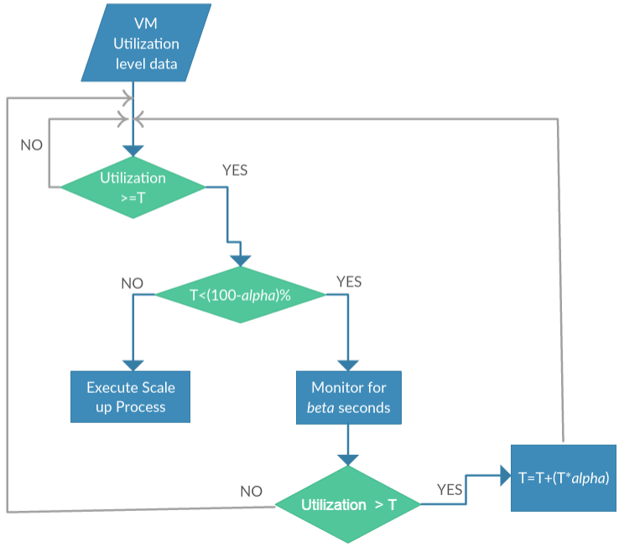
SCALING UP
Collected data is analyzed and the current utilization of the data is determined.
Test: current utilization > Threshold?
Once the test passes, check if Threshold is fully utilized.
If not, monitoring phase starts for β seconds.
By the end of the observation phase Is current utilization > threshold ?
Yes, threshold is increased by α percent.
Repeat until threshold >(100- α)% (full utilization)
Assuming α =10
Stop when T>90%

Slide 12
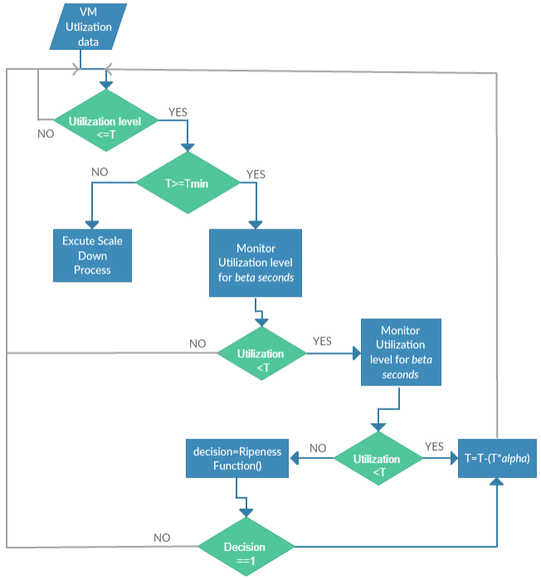
SCALING DOWN

Slide 13
Strengths and Weaknesses
Strengths:
Accurate
Reduced Costs
Leveraging real time data to adapt the threshold
Avoid false positive
Weakness:
Performance depends on the selection of the initial threshold and alpha.

Slide 14
Reinforcement Learning based Technique

Slide 15
Main Concept
The automation of the scaling task is not dependent on any pre-existing knowledge or any performance model of the application.
Scaling decisions are made and improved on while the application is running - using a trial and error approach.
Preliminary Concepts –
Agent - The auto scaler component in RL is known as the agent.
State - Current Application State.
Action - When a state change occurs in the application, the agent can choose to perform an action.
Reward - The action chosen for a given state is then rewarded according to the nature of the succeeding states.
“ The agent learns and assigns actions to different states in such a way so as to maximize collected rewards.’’

Slide 16
Architecture
Notifies
state change
Rewards
Action Performed
Reward the Action
Environment
Agent
Acts Upon

Slide 17
Review Paper – Brief Description (1/3)
Paper title – ‘Unsupervised Learning of Dynamic Resource Provisioning Policies for Cloud - hosted Multitier Web Applications.’ - Iqbal et. Al
They addressed auto scaling using RL for multi-layer web application.
Their proposed solution - complete auto scaler - both workload pattern prediction and resource provisioning policy learning.
For policy learning part - adaptive resource allocation for every tier - online unsupervised method for policy learning.
Policies – set learning agent to use a simplistic method to find the policies that maximizes the objective function and thus the reward – it does so by predicting the value of each possible action.
Only does vertical scaling - scaling process is triggered when an SLA violation is encountered.

Slide 18
Review Paper - Brief Description (2/3)
Implemented their approach in 2 algorithms for different phases - Exploration phase, which is the online learning phase - Exploitation phase which is the decision-making phase.
Exploration phase : -
Starting with no knowledge - the learning agent periodically monitors for SLA violations – once detected- it selects the action with the highest reward and applies it.
Exploring of all the possible actions is done using a simple exhaustive exploration algorithm.
Each of the states visited during this phase logged and later used to build a neural network regression model.
For given workload and tier configuration, this model will then be used to predict the service time required by the auto scaler for next phase.

Slide 19
Review Paper - Brief Description (3/3)
Exploitation Phase :-
When SLA violation is perceived - the value of each action is calculated by – first by using the regression model and predicting the service time that the action would take and then by calculating the reward.
Once that is complete, action with the maximum reward is selected.

Slide 20
Review Paper – Strengths and Weaknesses
Strengths
Considers both the raw arrival rate and the workload pattern - the learner is better at provisioning resources.
Scaling strategy - prioritize scaling out at the web tier over database tier for actions with same response time.
Selecting database tier - data synchronization in the database tier and overhead load balancing at the web tier
Weakness
Assumption that their system would always have sufficient bandwidth and enough time would be given to the auto-scaler to collect access logs, learn and implement a policy before workload changes occur.

Slide 21
Time Series Analysis based Technique

Slide 22
Main Concept
Auto-scaling problem can be divided into two main steps:
Prediction
Decision-making
Time series analysis can only be applied to the first step (i.e. prediction step).
Time Series prediction:
Based on analyzing historical data (i.e. performance metrics)
Performance metrics are periodically sampled at fixed time intervals, denoted as window size w.
The predicted performance metrics are used to allocate resources accordingly.
Common Time Series prediction techniques:
Moving average which based on Arithmetic Mean
Machine learning approaches

Slide 23
Review Paper – Brief Description
Paper title – ‘Hybridscaler: Handling bursting workload for multitier web applications in cloud’
This work proposed a hybridScaler algorithm for resource allocation which combines between horizontal and vertical scaling.
They propose an algorithm that gives the scaling-decision with the number of resources to allocate (VMs and VCPUs)
Vertical scaling
Horizontal scaling

Slide 24
Review Paper – Approach Overview
Why Combine both scaling techniques, horizontal and vertical?
Reactive horizontal scaling
VMs booting time overhead – ranges between 5 to 10 minutes
Proactive horizontal scaling
Short-term bursting workload cause extra cost and significant overhead.
Reactive vertical scaling
A lightweight approach which adds/remove VCPUs and RAMs instantly.

Slide 25
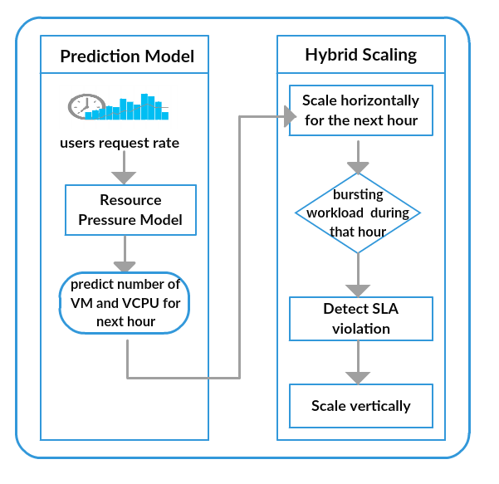
Review Paper – Approach Architecture
Performance metrics used:
Users request rate
Resource Pressure Model which based on Time Series Analysis to predict:
Number of VMs
Number of VCPUs
First action → to scale horizontally for the next hour.
SLA violation detection → scale vertically

Slide 26
Strengths and Weaknesses
Strengths:
The algorithm is able to handle the spike (i.e. burst workload)
Minimize SLA violation
Not only scaling decision, but it predict number of resources to allocate.
Weakness:
Assume that all VMs are homogeneous.

Slide 27
Evaluation of Techniques

Slide 28
Reactive based techniques
Overhead delays in the auto scaling process. - allocated resources need to be setup at the time of need.
Threshold-based techniques are no longer the trend- used in collaboration with other techniques to overcome their weaknesses

Slide 29
Proactive based techniques
Introduced to solve the problem of overhead delay seen in reactive based
Weakness of proactive techniques - don’t perform well in cases of short-term burst workloads.
Strength of RL - Ability to easily be plugged and used in any application on the go.
Strength of TSA - Applications with predictable workload patterns and stored application logs and usage details.
Weakness of RL - Learning process in most cases a time-consuming process - may become impractically long in some cases.

Slide 30
Conclusion

Slide 31
Strengths and Weaknesses
For our review,
Discussed various techniques used in the literature to solve the scalability problem in cloud computing.
Discussed the strengths and weaknesses of the different techniques.
Shed some light on where each of the techniques would likely be better suited to be used.
Noticed that recent works are now focusing more on the predictive techniques rather than the reactive techniques. - proactive methods facilitate a more faster solution to the scalability process.
Findings - Currently lot of research being done to try to improve proactive approaches so as to handle this sudden change type of workloads.

Slide 32
Thank You!

